Slide 1
Accessibility Allies at University of Southampton
How five interns improved accessibility for more than 6000 students.
Notes:
Matt:
Hello! Welcome to our presentation ” Accessibility Allies at University of Southampton: How five interns improved accessibility for more than 6000 students.”
“Next slide please Helen”

Slide 2
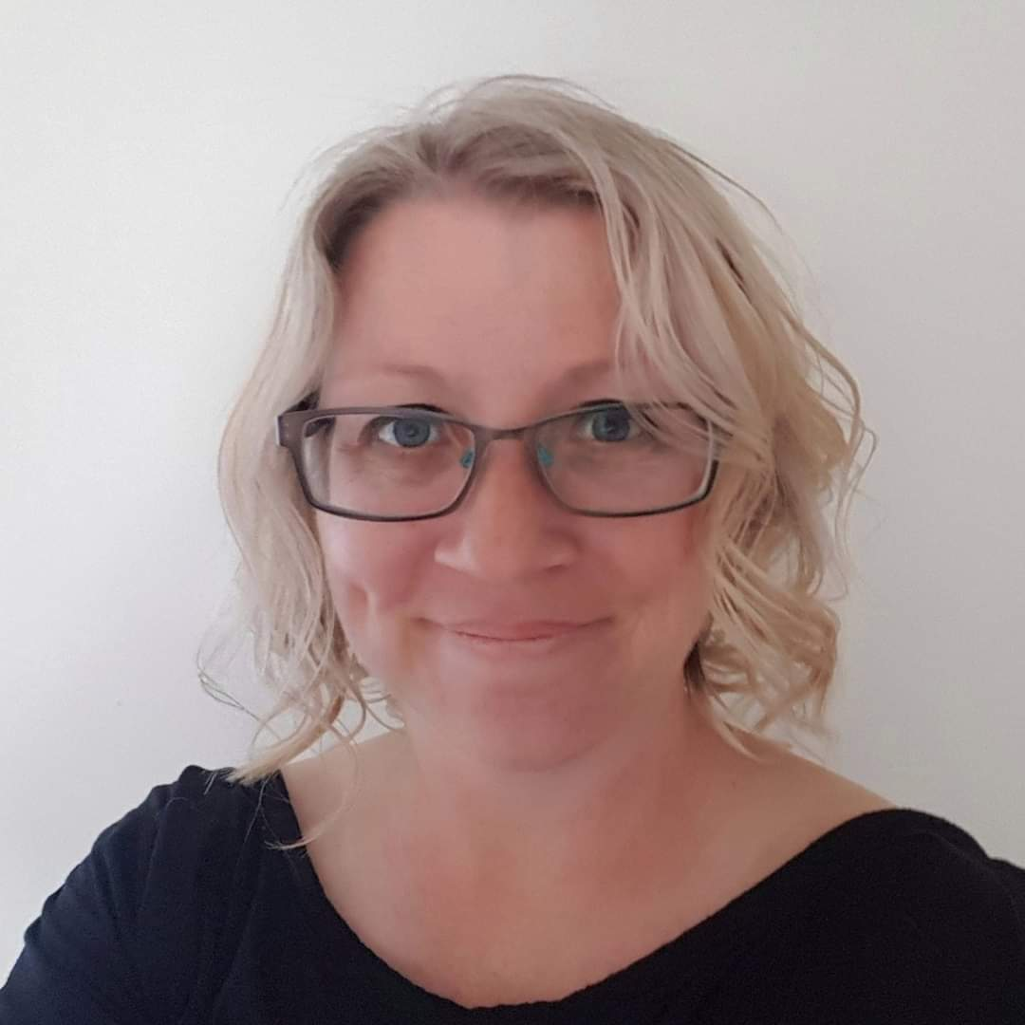
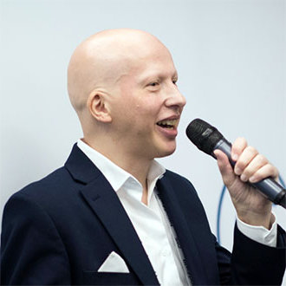
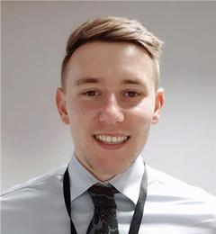
Who are we?
Dr Sarah Fielding
Digital Learning Team Manager
@Shieldingafar
Matthew Deeprose
Senior Learning Designer
@vleguru
Luke Searle
Learning Designer
@LukedInLearning
Notes:
Matt
I’m Matthew Deeprose, and I’m joined by my colleagues Dr Sarah Fielding and Luke Searle, we’re based in the Digital Learning Team at the University of Southampton.
“Next slide please Helen”

Slide 3
What will we cover today?
Introduce Blackboard Ally.
How the internship worked.
Our appointment of five interns to improve content accessibility.
Sharing our lessons.
Notes:
Matt
So what will we cover in our session today? Some of you may not be familiar with Blackboard Ally, around which our internship was centred. So, we’ll give you a very quick overview of this tool. We’ll talk about how we appointed five interns to improve the accessibility of module content and explain aspects of how the internship worked. We’ll finish with some reflection on the success of our interns and share the lessons we learned that would change our approach if we were to run this exercise again.
“Next slide please Helen”

Slide 4
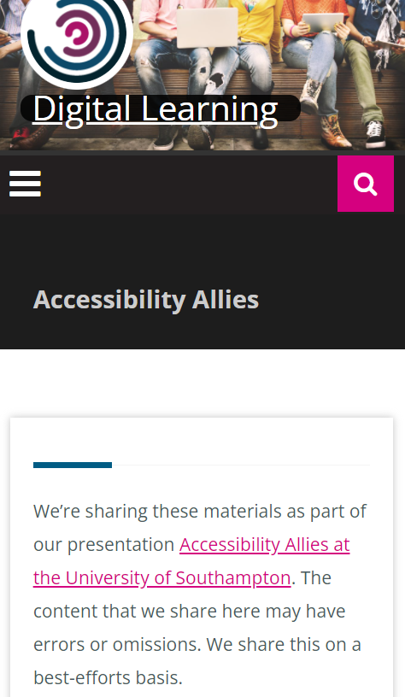
Online materials available
https://go.soton.ac.uk/allies
Notes:
Matt
You may be inspired to run a similar internship at your institution, so to help you get started we’ve shared as many of the assets we created so that you wouldn’t need to start from scratch. You can find these as well as a copy of our slides at go.soton.ac.uk/allies
“Next slide please Helen”

Slide 5





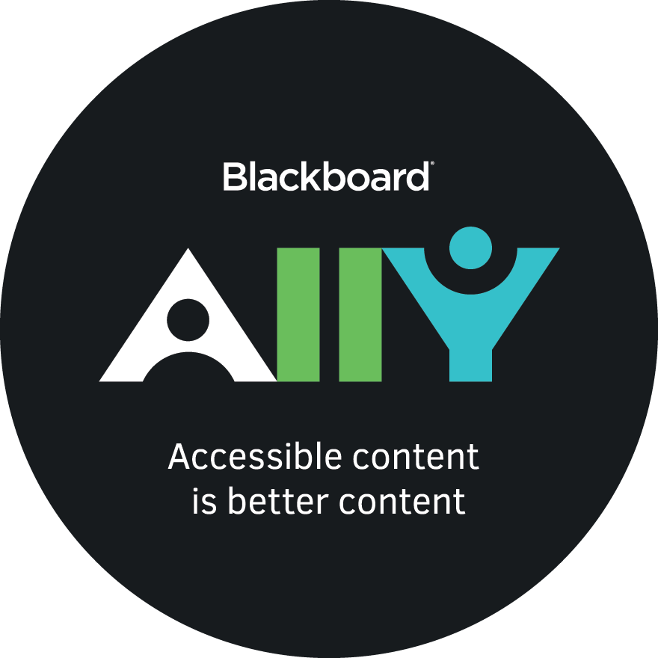






About Ally: Alternative formats 0
Original module materials
Alternative formats
Notes:
Matt
So what is Blackboard Ally? It’s a commercial addon for your Virtual Learning Environment, such as Canvas, Moodle, or Blackboard.
Using Ally, students can obtain accessible alternative formats that suit their preferences and environment. Formats include an mp3 version to listen to, an epub version to use on a e-Reader device such as a Kindle, or “Beeline reader” which is proven to assist readers with dyslexia or ADHD.
This is a great way of standardising accessibility. In many cases students will no longer need to request accessible alternative formats. They’re just generated on request from within the VLE. This feature benefits all students, not only those with an impairment or disability, freeing up our Student Disability and Inclusion Team to support more complex support needs.
“Next slide please Helen”

Slide 6
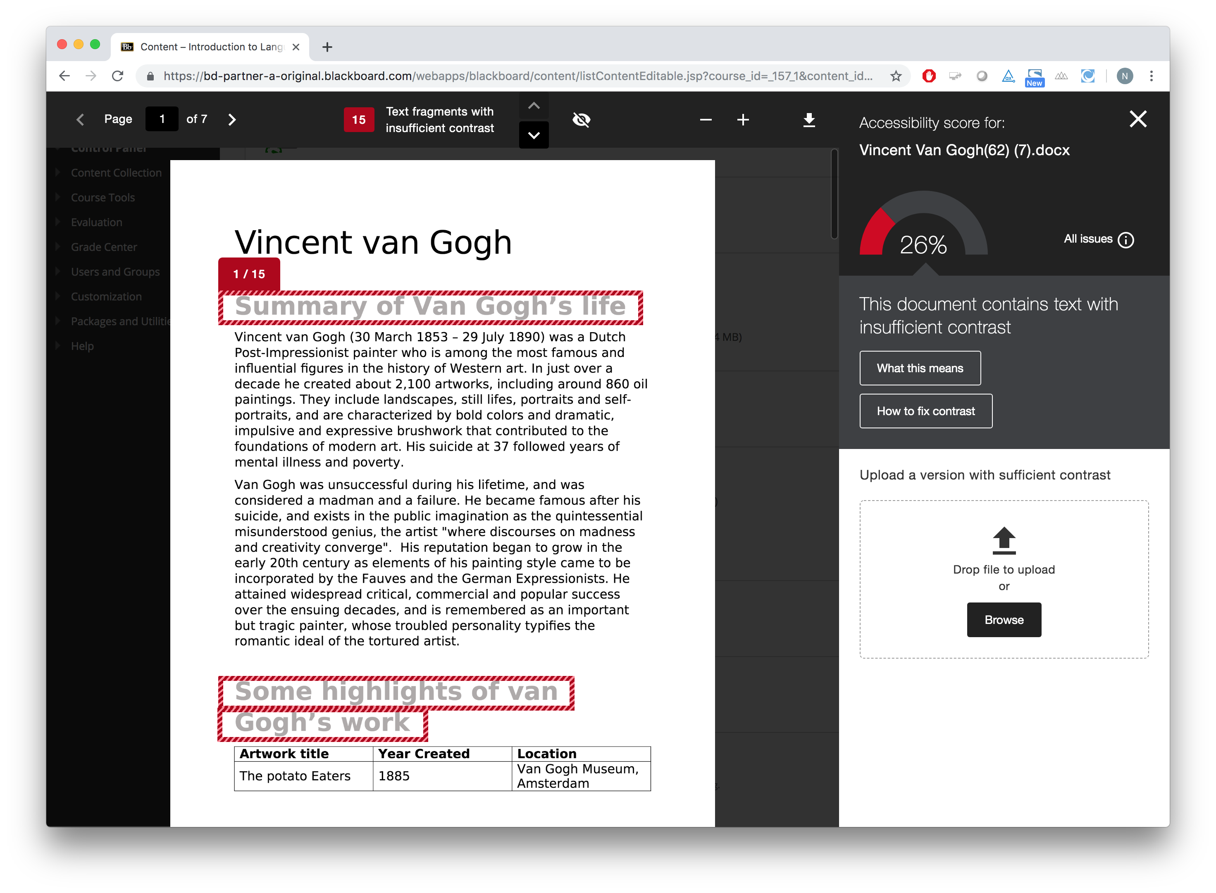
About Ally: Assist staff with accessibility 2
Notes:
Matt
The more accessible the original file, the better the alternative format will perform. This introduces the second part of Ally: helping staff to make their content more accessible. Ally helps staff to identify accessibility issues within their content and explains why it is important to resolve them. Ally provides easy to follow on-screen guidance on remediating the accessibility defects that it finds within module content.
“Next slide please Helen”

Slide 7
Ally Reporting / Initial Rollout plans
How accessible are the files uploaded to Blackboard?
Recruitment of 5 interns (“Accessibility Allies”) to conduct targeted remediation work.
Student/staff facing comms / videos about the benefits and use of Ally.
Ally “roadshows” and outreach activities.
Notes:
Matt
Ally allows us to measure the accessibility of resources uploaded across our whole institutional Virtual Learning Environment. For us, the most important metric is the “File accessibility score”. This is a percentage where the higher the score, the more a file meets accessibility guidelines.
Our initial rollout of Ally began in July this year, we had funding to recruit five interns to perform targeted content remediation of module files over the summer. Of course we also ran a communications campaign, “roadshows” and other outreach activities.
“Next slide please Helen”

Slide 8
Accessibility Allies! Preparation and initiation
Accessibility Allies
Preparation and initiation
Module remediation work
Additional activities
Reflecting on the internship
Notes:
Matt
We’ve broken our presentation down into four parts. Now I’m handing over to Luke to talk about the preparation and initiation activities.
“Next slide please Helen”

Slide 9
Our expectations for the internship
For us to learn about Ally quickly.
Deliver rapid accessibility improvements in priority modules.
Identify top areas for staff development.
Encourage a variety of student viewpoints, inform our communications about Ally and accessibility.
Notes:
Luke
Thank you Matt.
Thinking about our expectations for the internship, we saw this as a great chance to learn quickly about Ally, realising the value of our investment in Ally by delivering rapid improvements in the accessibility of prioritised modules.
We hoped that our Accessibility Allies would help us to identify common themes and the top areas for future staff development.
We also wanted to receive a variety of student viewpoints that informs our approach for student communications about Ally and the wider topic of accessibility.
“Next slide please Helen”

Slide 10
Recruitment
Digital Learning is looking to recruit 5 full time summer interns as part of the Blackboard Enhancement Project. Part of the project includes the rollout of Ally, a tool to help us identify and fix accessibility issues in online learning materials.
Our Accessibility Allies (interns) will be working with us to provided targeted support. This is an excellent opportunity to learn more about digital accessibility, work with our team of Learning Designers, and to help make a change for the better for all students Successful candidates will gain a range of transferable skills as well as a valuable insight into ‘digital inclusion’.
Day-to-day, the work will involve checking and amending the following aspects of Word documents, PowerPoints, PDFs and other file types:
heading structure
labelling of data tables
image descriptions
accessible colour contrast
meaningful link text
Large number of applicants
Bucked a trend in gender gap in internships
Notes:
Luke
We advertised the internship through our career service’s internship platform and attracted a large number of applicants.
Typically, while female students provide 52% of applications and shortlisted candidates, only 47% of appointed interns are female students. 80% of our appointed interns were female.
In the interview, applicants were asked to suggest how an inaccessible document could be more accessible. We also asked, how they would approach the topic of accessibility with an academic colleague, for whom digital accessibility is not a priority.
Staff have worked extremely hard with the rapid move to online learning. We want to bring our academic colleagues along with us when considering accessibility, not present them with yet another thing that they don’t have time to do.
“Next slide please Helen”

Slide 11
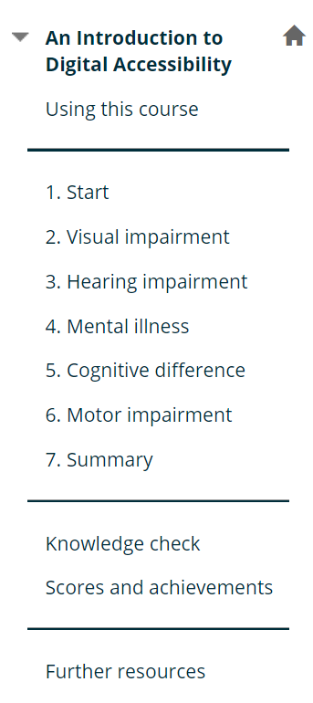
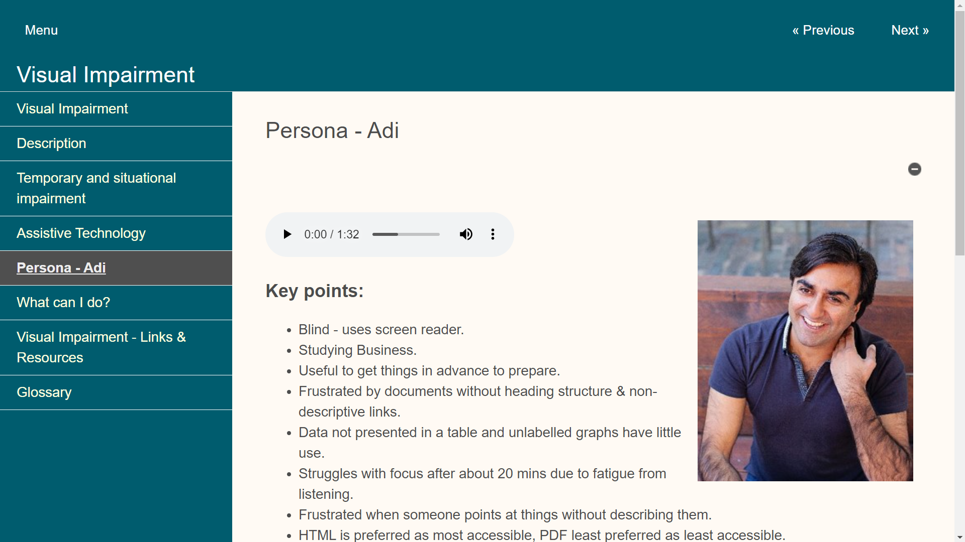
Training materials
Microsoft Accessibility fundamentals
Creating accessible documents in Word and Adobe Acrobat (LiL)
AbilityNet’s “Accessibility and Me: Lived experience”
Notes:
Luke
As part of the induction activities for our Allies, we identified a number of training materials. These included Microsoft’s free “Accessibility Fundamentals” module and resources from LinkedIn Learning.
They also tested AbilityNet’s Accessibility courseware which we had just integrated within our Blackboard VLE. This module includes personas, use-cases, and examples of accessible practices.
There was also a quiz to be completed. The quiz was set up so that a score of 80% or higher would result in a module completion certificate, and those with a score of 100% would be rewarded with a digital badge. Almost 1000 staff and students have now completed this module.
As the internship progress we provided further training and resources based on issues and questions that arose.
“Next slide please Helen”

Slide 12
Identifying modules for remediation
“File score” below 50%
More than 150 students enrolled?
Selected by the faculty?
Module leader agrees?
Content authors available?
No updates planned?
Into the remediation queue!
Notes:
Luke
As for how we identified which modules our Allies should work on, we used Ally data to identify modules with a “file score” below 50%. We wanted the work of our Allies to have the greatest impact possible. We filtered this list to find modules with more than 150 students enrolled.
We then worked with faculties to prioritise modules from that initial pool. Then, provided the module leader agreed, content authors were available and that there were no planned updates to the module, we could place that module into our remediation queue.
“Next slide please Helen”

Slide 13
Process for content remediation
Starting
Record initial accessibility scores.
Take backup of all files, upload to central area.
Working
Remediate module content accessibility, using guidance provided.
Aim for a 40% increase in file accessibility, as rated by Ally.
Completing
Record finishing accessibility scores.
Debrief module leader.
Request original files from module leaders if they have used PDFs.
Notes:
Luke
We developed a simple process for working through the modules. At the beginning we would record the initial accessibility scores and take back ups of all files – just in case.
The Allies could then begin their remediation work following the guidance we provided.
Staff sometimes share PDF files on their modules. These PDFs would typically be created from standard Office documents. To sustain improvements in accessibility, we requested the original course files from our colleagues and the Allies remediated those.
That means that if staff update the original files and create new PDFs, the accessibility benefits should be sustained. We recommended to upload the original Office document anyway, as students can access a tagged PDF through Ally.
We asked our allies to aim for a 40% increase in the file accessibility score. Once work was complete a debrief meeting, led by an Ally, was arranged with the module leader.
“Next slide please Helen”

Slide 14

How to remediate content guide
A single, living document:
detailing the process
explaining step by step how to resolve accessibility defects identified by Ally
Notes:
Luke
As well as the initial training we created a single, living document. The document explained the process end to end, and how to resolve each accessibility issue that Ally identifies.
“Next slide please Helen”

Slide 15
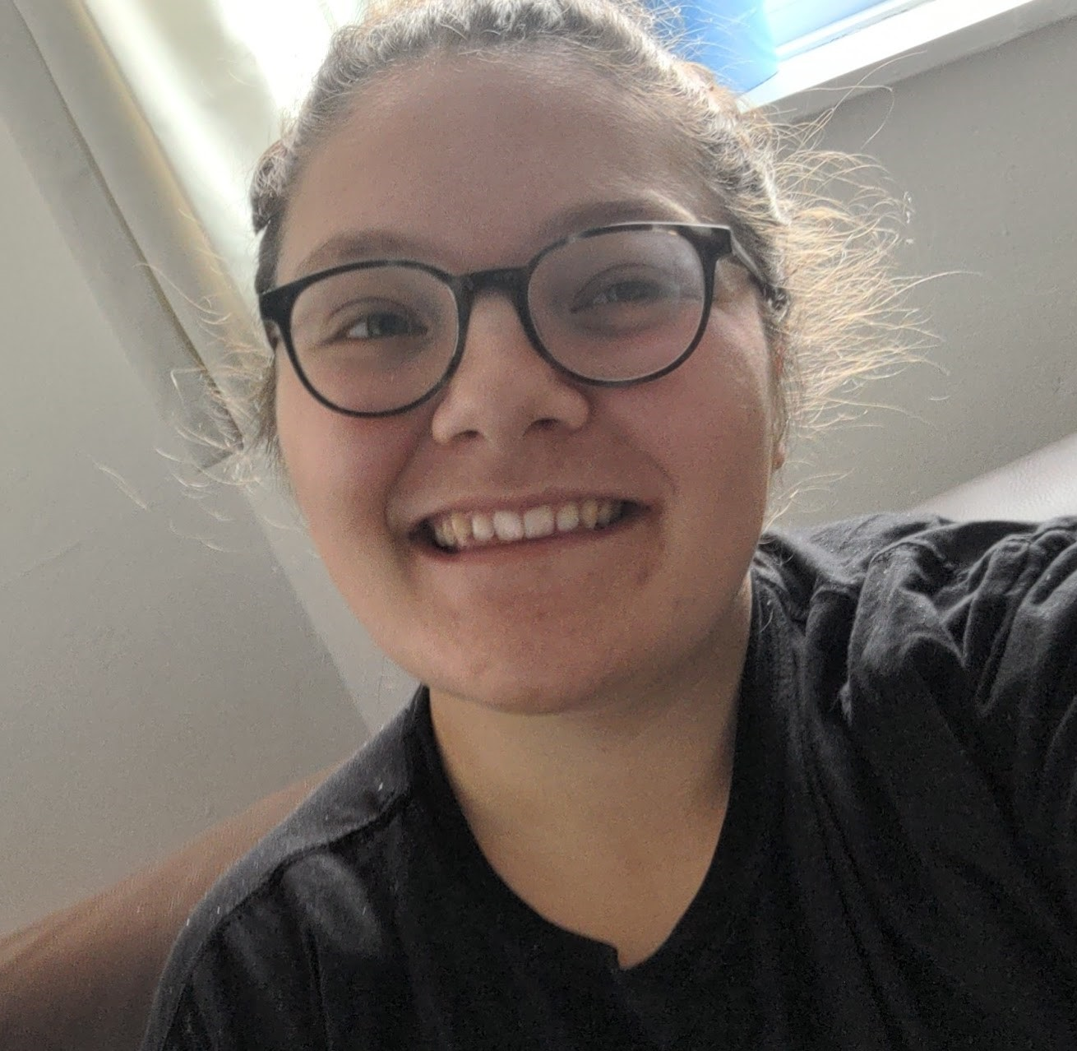
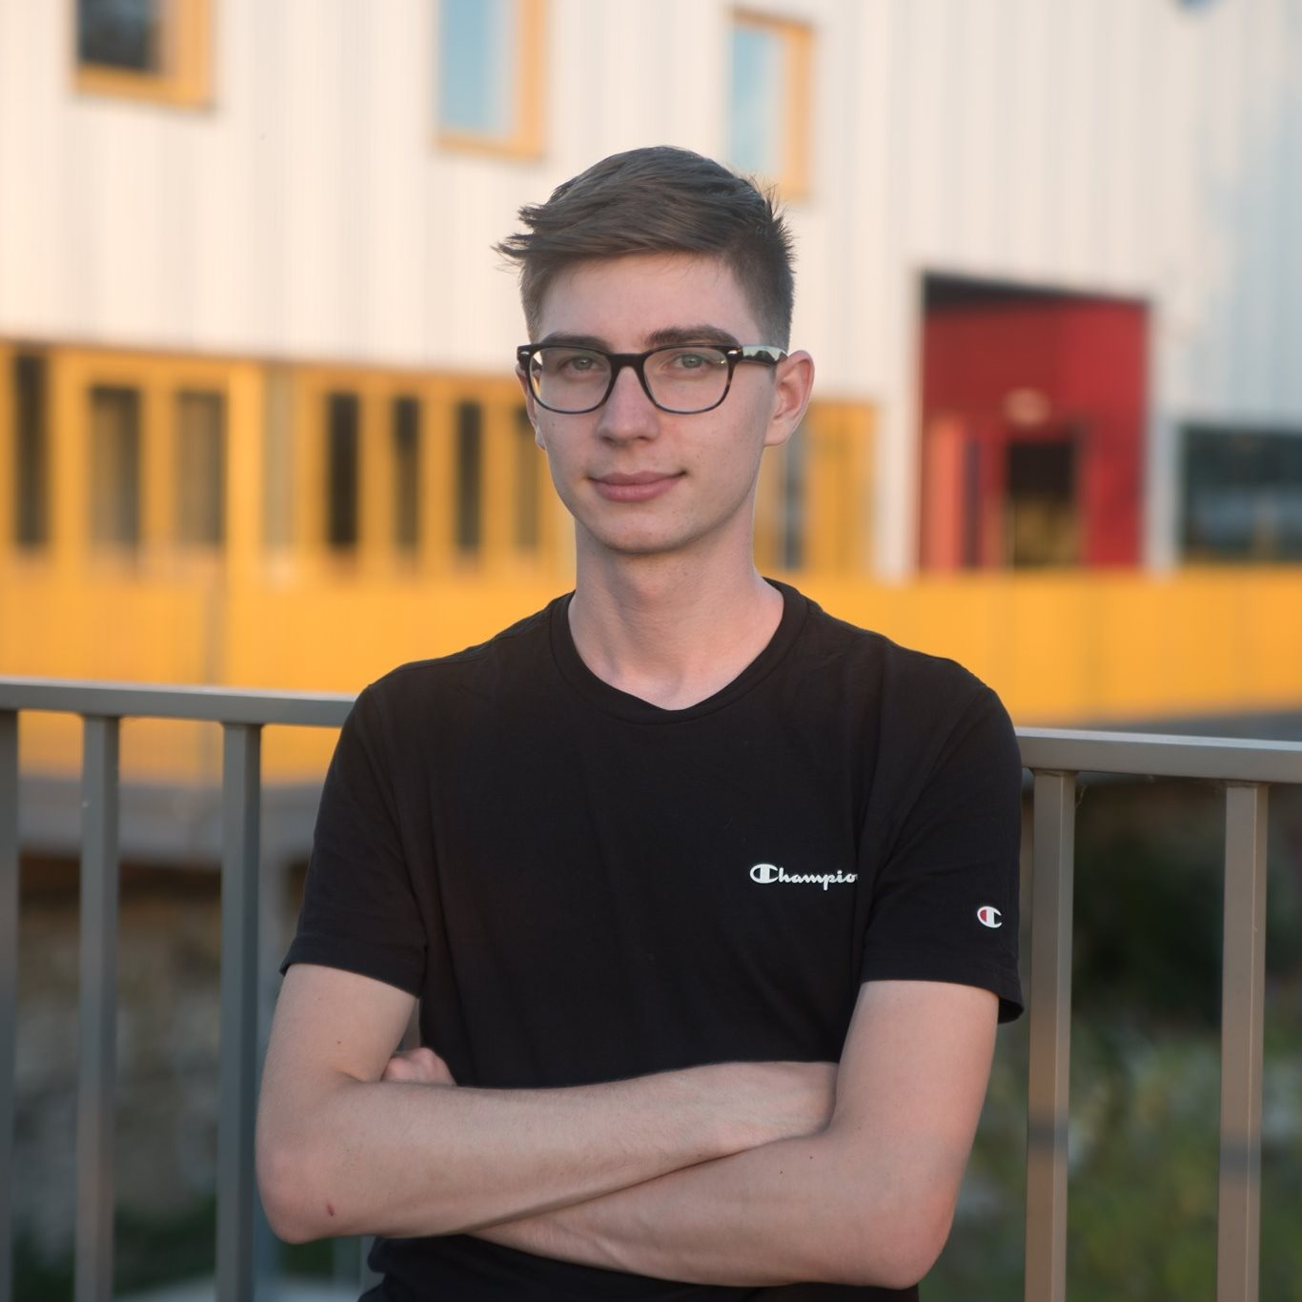
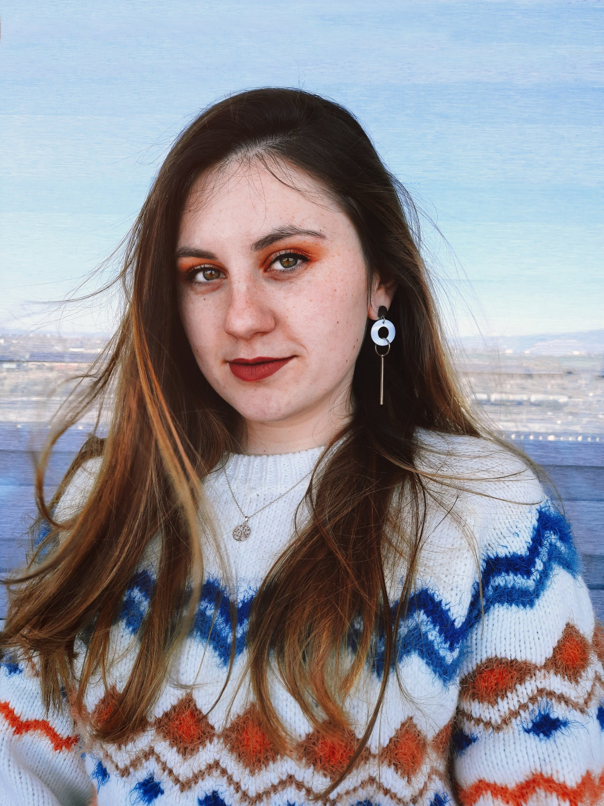
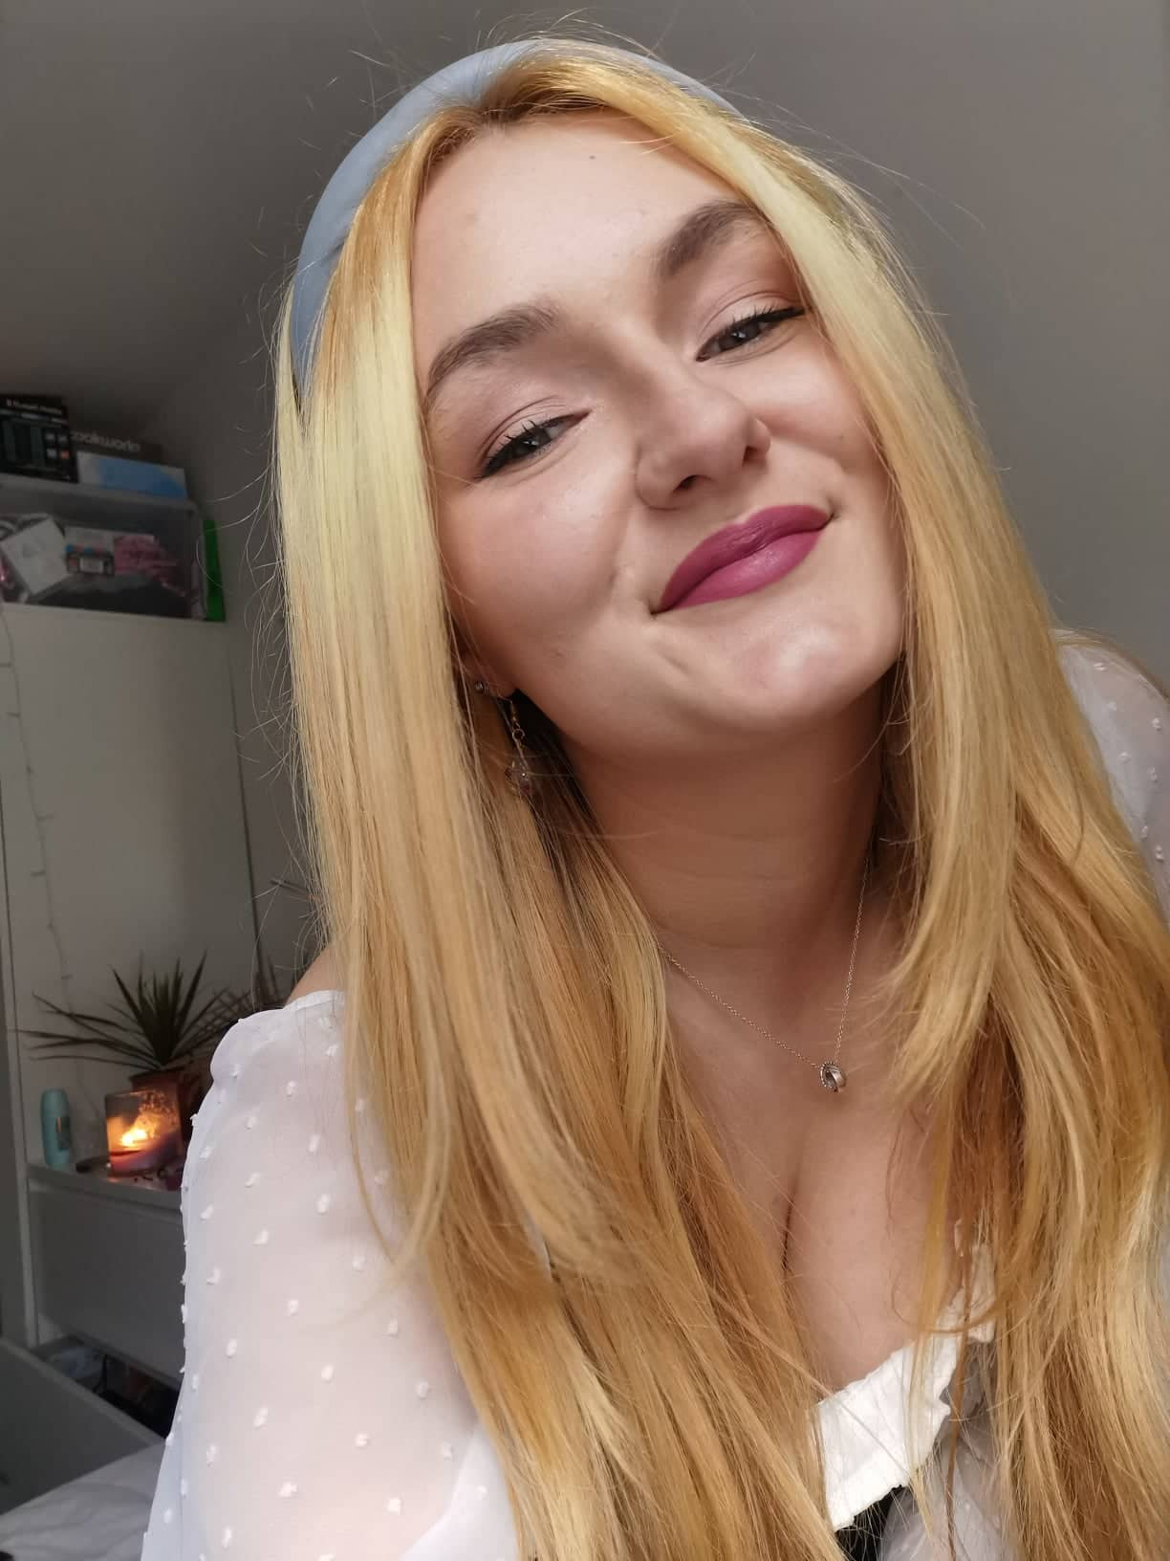
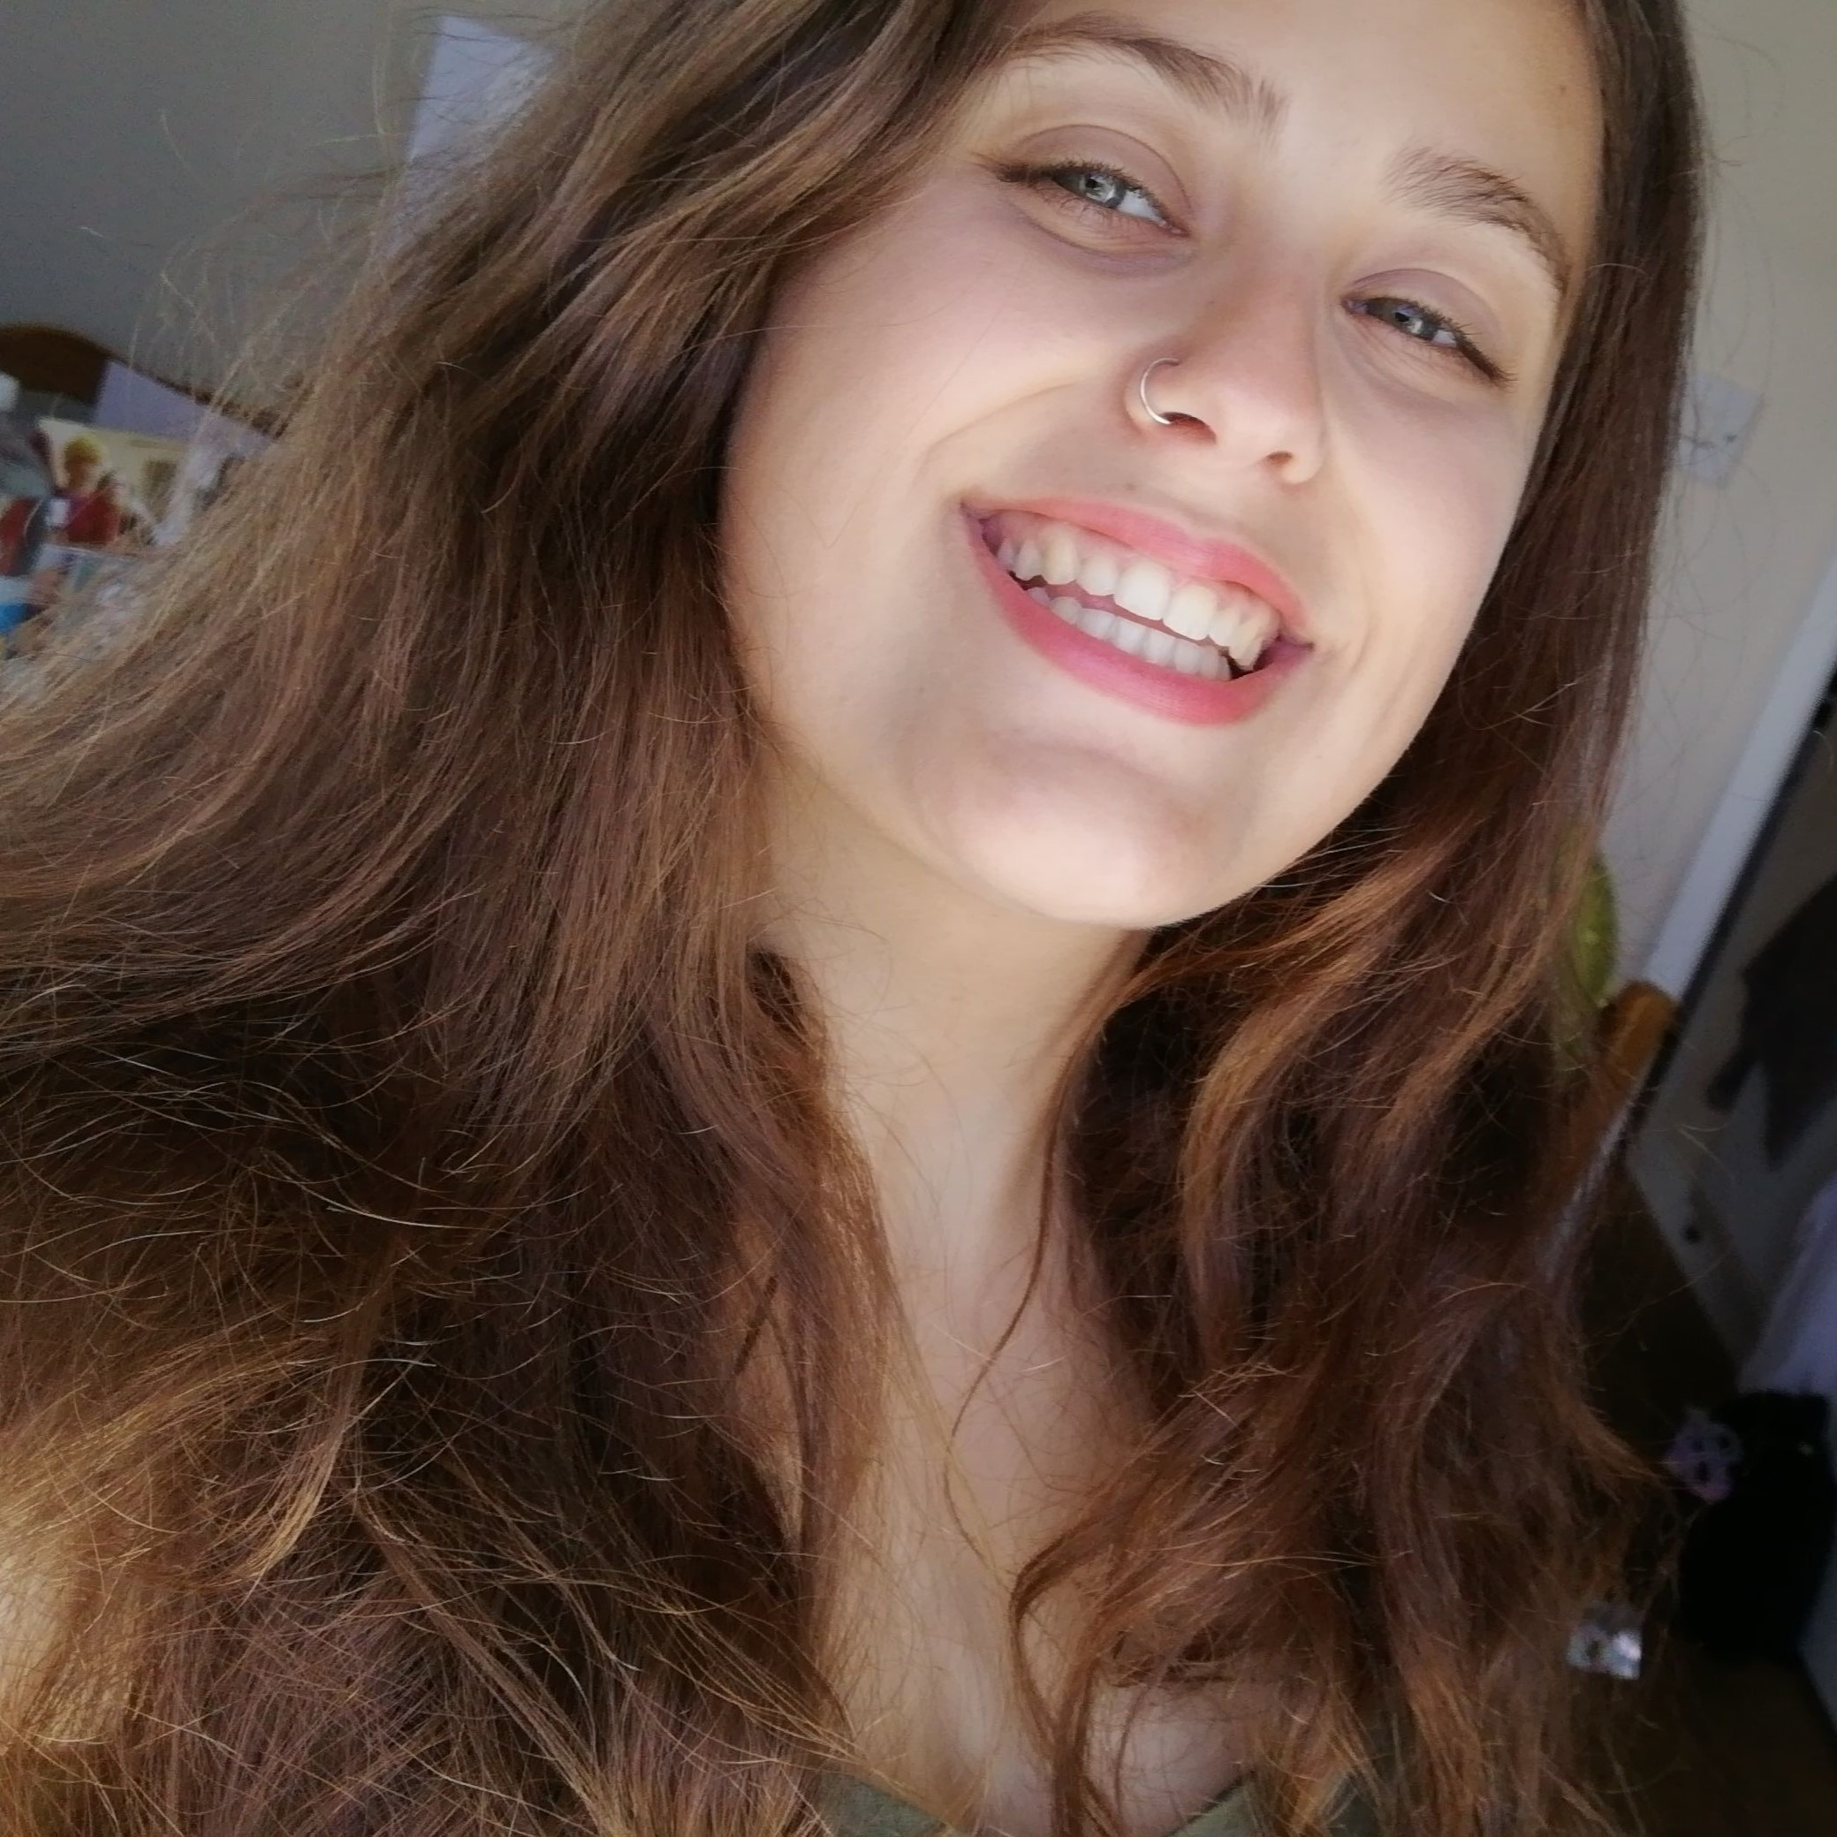
Accessibility Allies Assemble!
Charlotte
Velina
Stefan
Emily
Sian
Notes:
Luke
And so our programme was ready to begin, and we were lucky to be joined by
Charlotte Cockram
Emily Litchfield
Stefan Wiecek
Sian Brookes
and Velina Valcheva
“Next slide please Helen”

Slide 16
Accessibility Allies! 2
Accessibility Allies
Preparation and initiation
Module remediation work
Additional activities
Reflecting on the internship
Notes:
Luke
So the allies were in place and we had prepared all the processes and guidance. Now module remediation work could begin.
“Next slide please Helen”

Slide 17
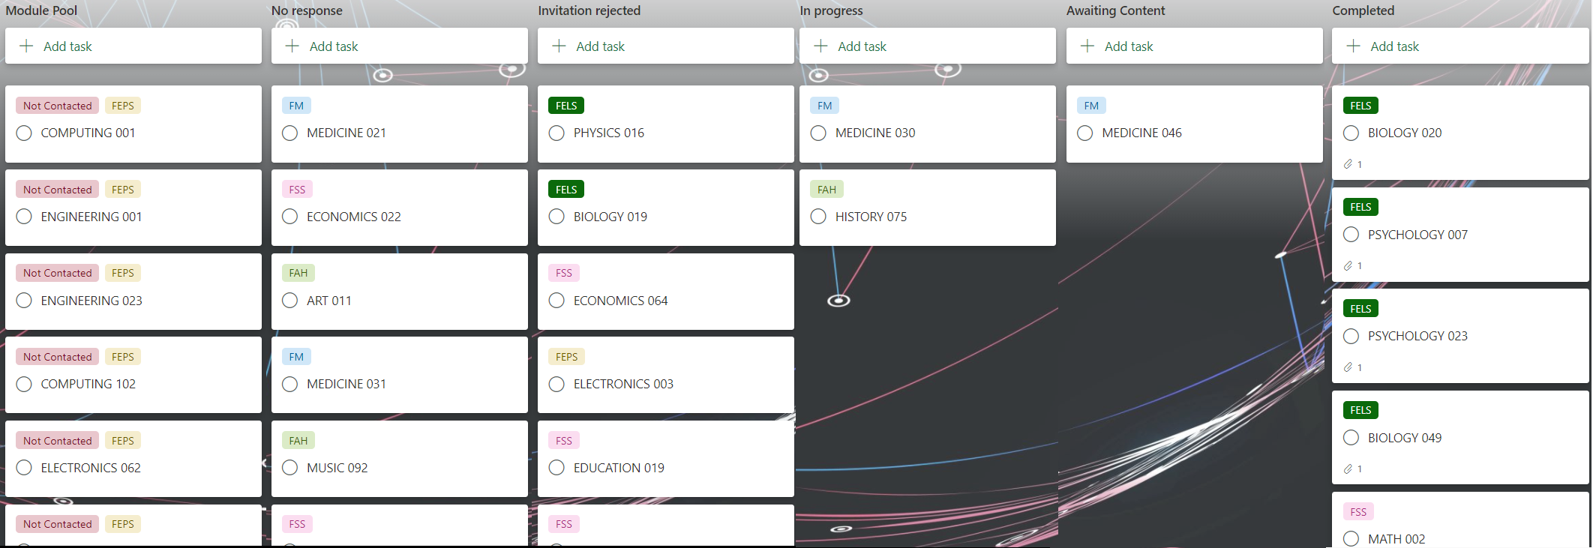
Using MS Planner to build a Kanban board 2
Notes:
Luke
To keep track of progress, we developed a Kanban board using Microsoft planner. All the scoped modules were added as cards on the left and they moved to the right as they pass the various gateways of our process, until they reach their final destination in the completed column.
This was a useful visual representation of where we were at any time throughout the project.
“Next slide please Helen”

Slide 18
Supporting Remediation activities
Discuss issues via Teams and in stand-ups.
Accessibility subject matter experts available via chat.
Notes:
Luke
Of course, we supported our allies, we had weekly team meetings and regular 15 minute stand ups. We were also using teams channels for collaboration.
Subject matter experts were on-hand and available via instant messaging to provide rapid support to our allies.
“Next slide please Helen”

Slide 19
Most common remediation techniques
Taking content out of tables that were not used for tabular data
Alternative text on diagrams
Fixing contrast issues
Applying / fixing headings
Reading order
Linking scans of journal articles to their original online version
Notes:
Luke
On screen are some of the most common remediation techniques.
To pick out a couple:
When tables are used for layout purposes and not for tabular data, it can be very difficult for those who use a screen reader or listen to an MP3 alternative format. Our Allies would edit the content so that it did not use a table. This is a good example of something that Blackboard Ally does not report and how our allies went further.
Also, the Allies had to apply headings styles to documents. Using heading styles improves the experience for those using a screen reader or the epub alternative format.
“Next slide please Helen”

Slide 20
Subject matter expertise required?
No
Headings
Contrast
Pictures of text
Colour as only form of meaning.
Tables
Alternative text for some images
Yes
Alternative text for some images
Notes:
Luke
You might ask whether it’s important to be a subject matter expert?
Our five allies were each randomly assigned to one of our five faculties, despite the majority of them studying computer science. We would argue that the majority of remediation techniques are about changing the structure, not the content and therefore in most cases subject matter expertise is not required.
HOWEVER: The team decided that subject matter expertise would be required to write meaningful and accurate alternative text. To overcome this, they made notes to share during the debriefing meeting. The topic of alternative text for images will be taken up as part of our wider work on the implementation of Ally at UoS.
“Next slide please Helen”

Slide 21
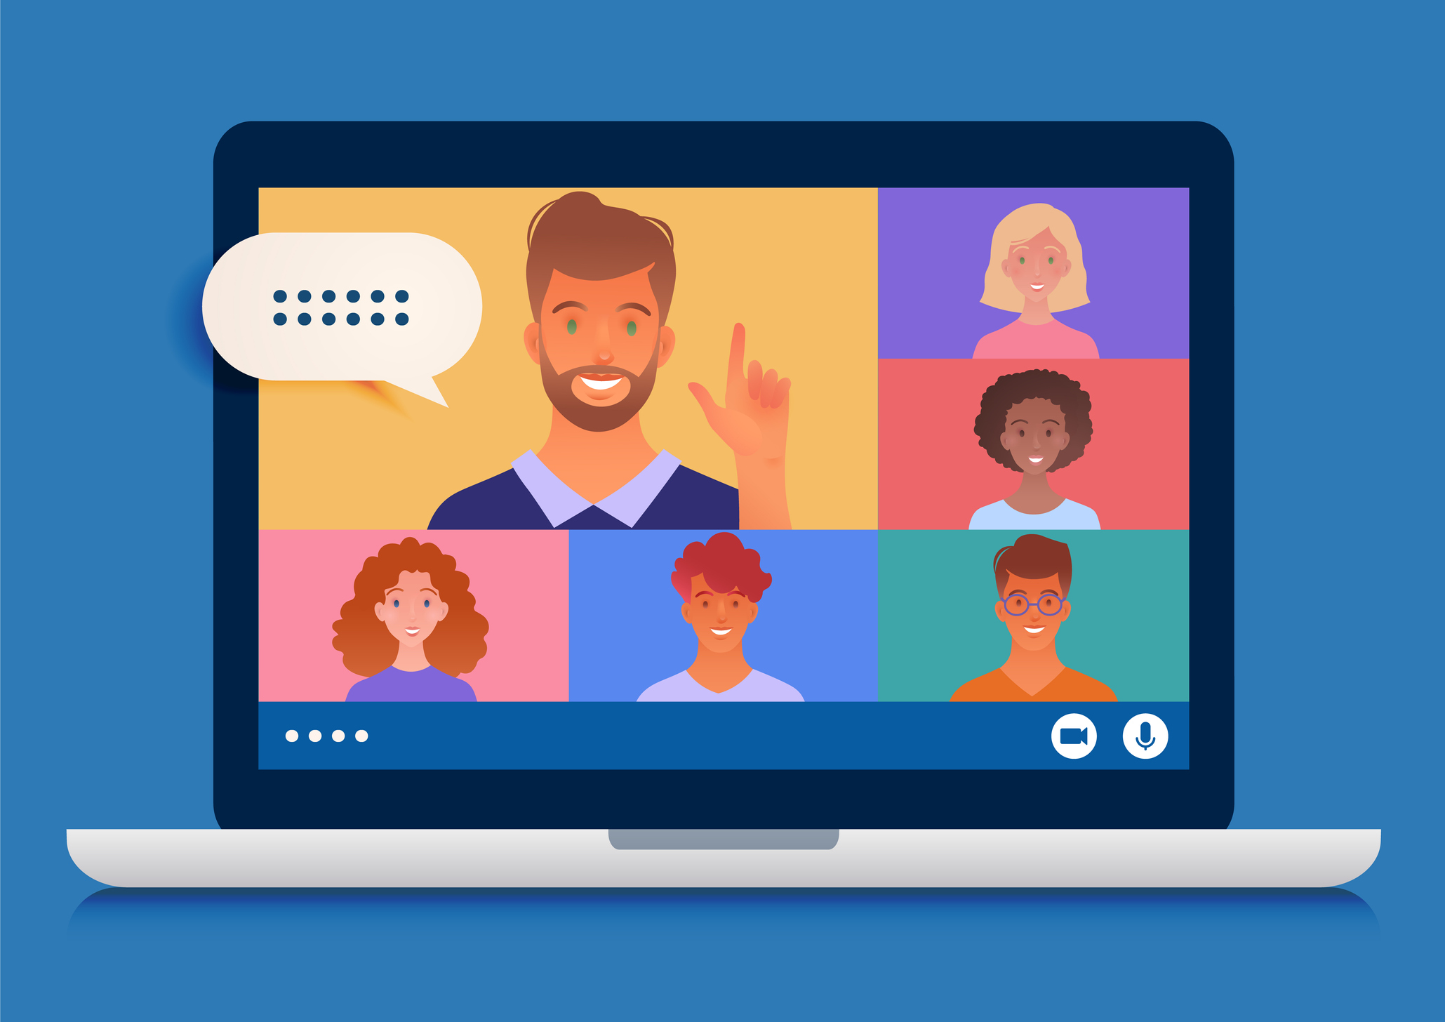
Debriefing the module leads
Led by the Ally using a presentation template.
Topics included:
Introducing the Ally and the project.
Details of remediation work:
Change in score
Common types of remediation
Further guidance
Notes:
Luke
Once remediation work was complete, a debrief meeting was arranged with the module leader. This provided a good opportunity for our allies to lead meetings with senior colleagues.
We created a presentation template to scaffold the meeting. This tended to lead to wider discussions. What the module leaders really appreciated, was the chance to ask questions and clarify their understanding of different accessibility issues and how they could make improvements to their own workflows.
“Next slide please Helen”

Slide 22

Let’s hear from our interns!
Notes:
Luke
Let’s listen to the thoughts of Sian and Velina on the challenges and opportunities of content remediation.
After the video, Sarah will discuss some of the additional activities our allies took part in.
“Could you play the video, please Helen?”
[at video end] “Next slide please Helen”

Slide 23
Accessibility Allies! 3
Accessibility Allies
Preparation and initiation
module remediation work
Additional activities
Reflecting on the internship
Notes:
Sarah
Thankyou Luke and good afternoon everyone.
Internships should be meaningful work and provide skills development for the students. It should not be a repetitive task that just has to be done.
So we were keen to work with our allies to identify other ways they could support our rollout of Blackboard Ally.
“Next slide please Helen”

Slide 24
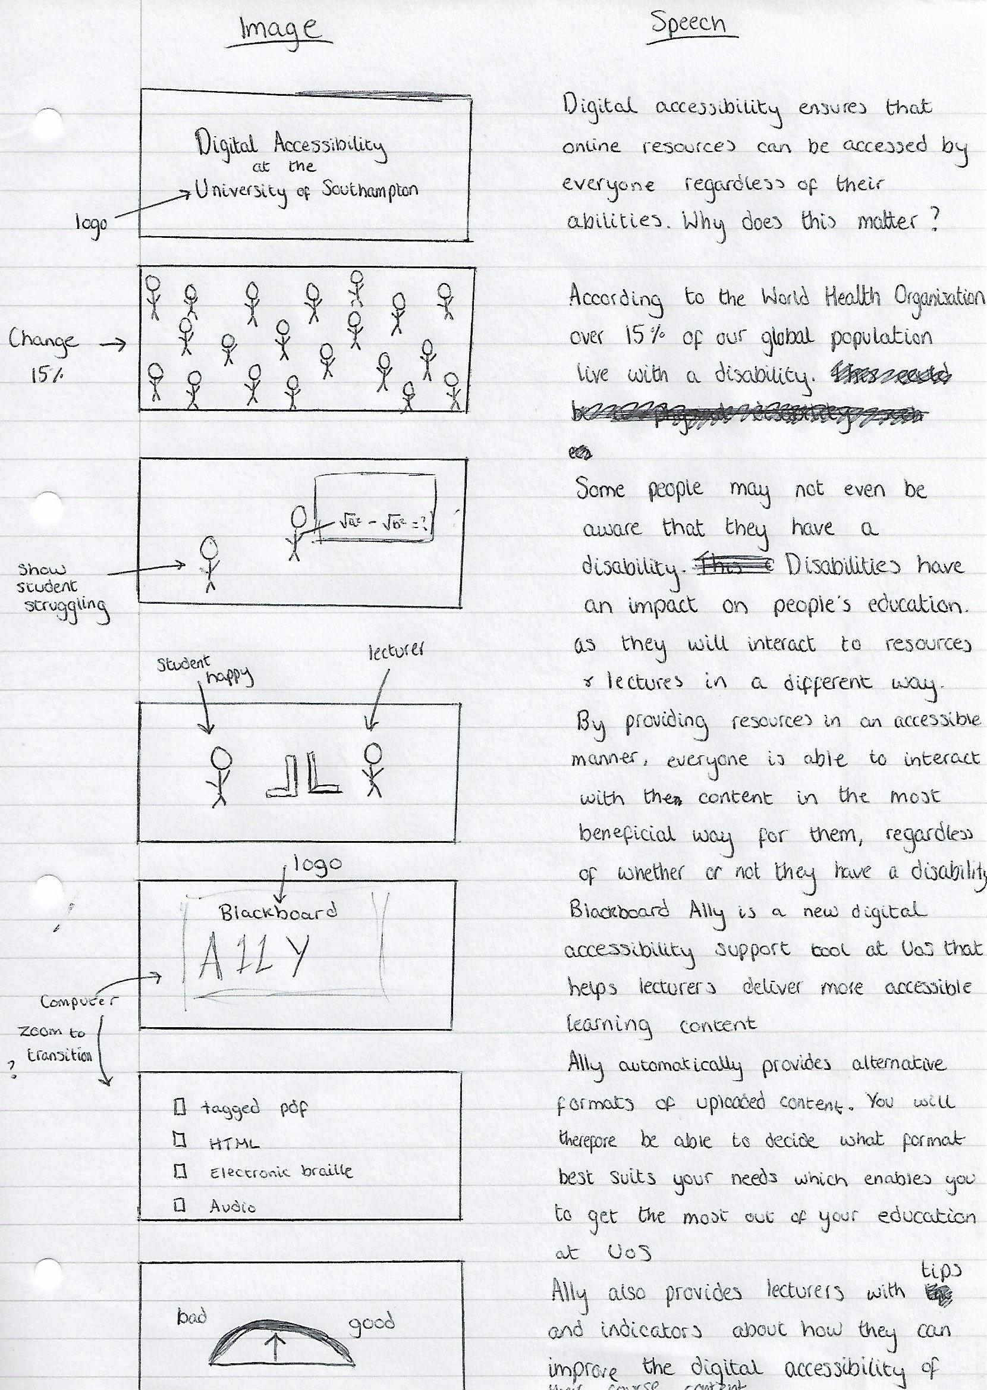
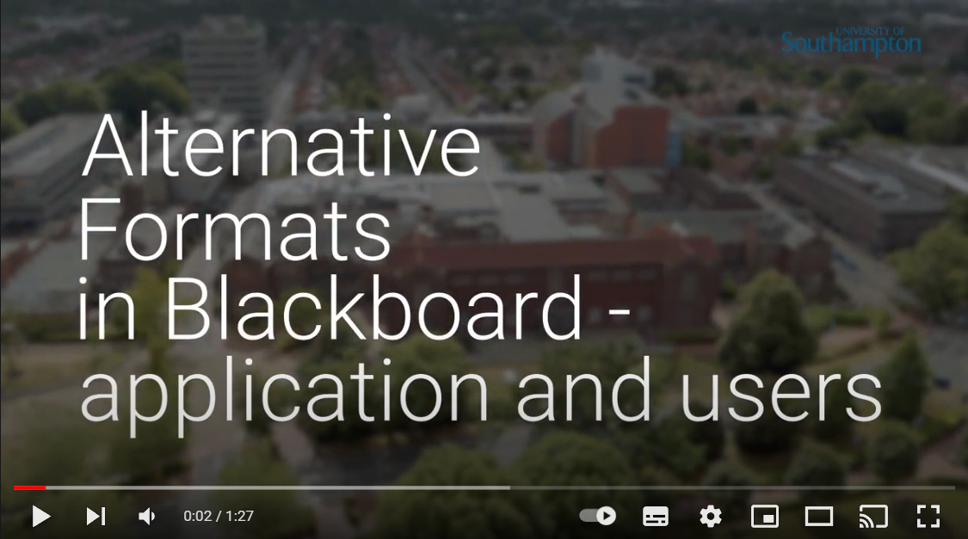
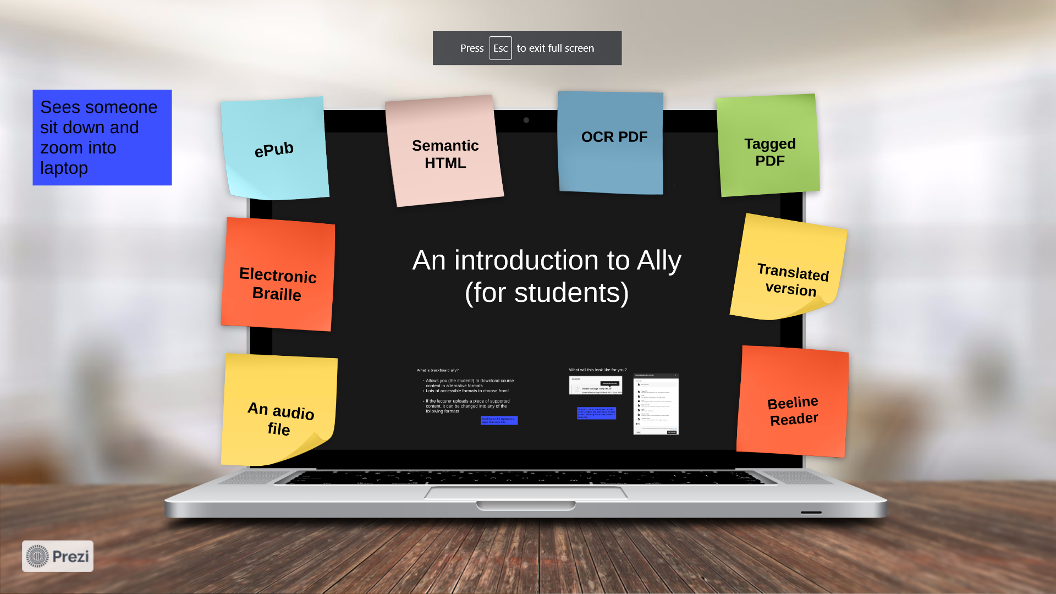
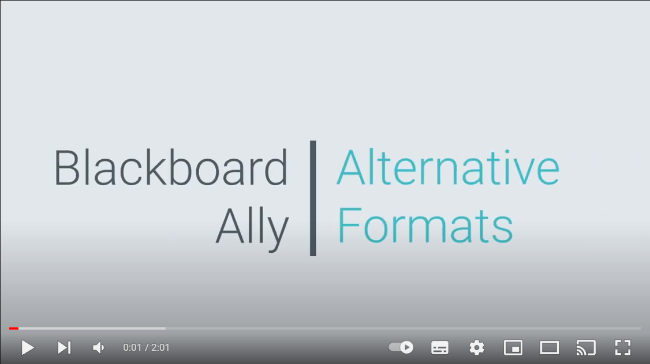
From storyboard to video
Notes:
Sarah
During the first weeks of the internship, we asked our allies to create storyboards for videos aimed at students. These would explain the benefits of alternative formats and digital accessibility.
They then worked with our Media team to produce high quality professional videos. You can view these on the resources page we shared earlier.
The videos were shared on official UoS Facebook pages, and were even picked up by Blackboard and promoted on their twitter account.
“Next slide please Helen”

Slide 25
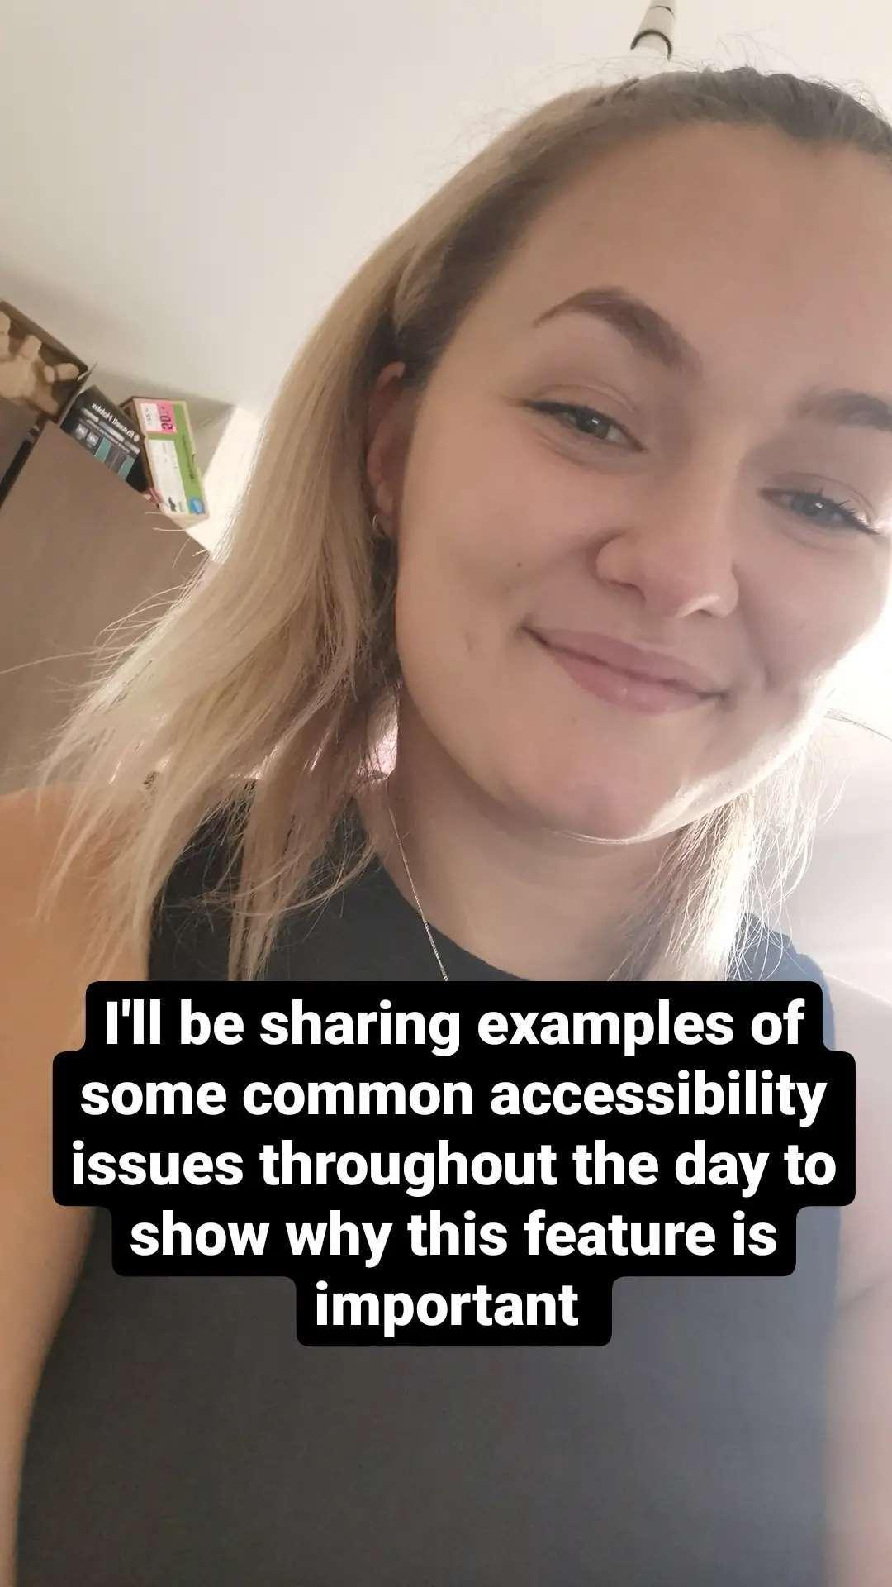
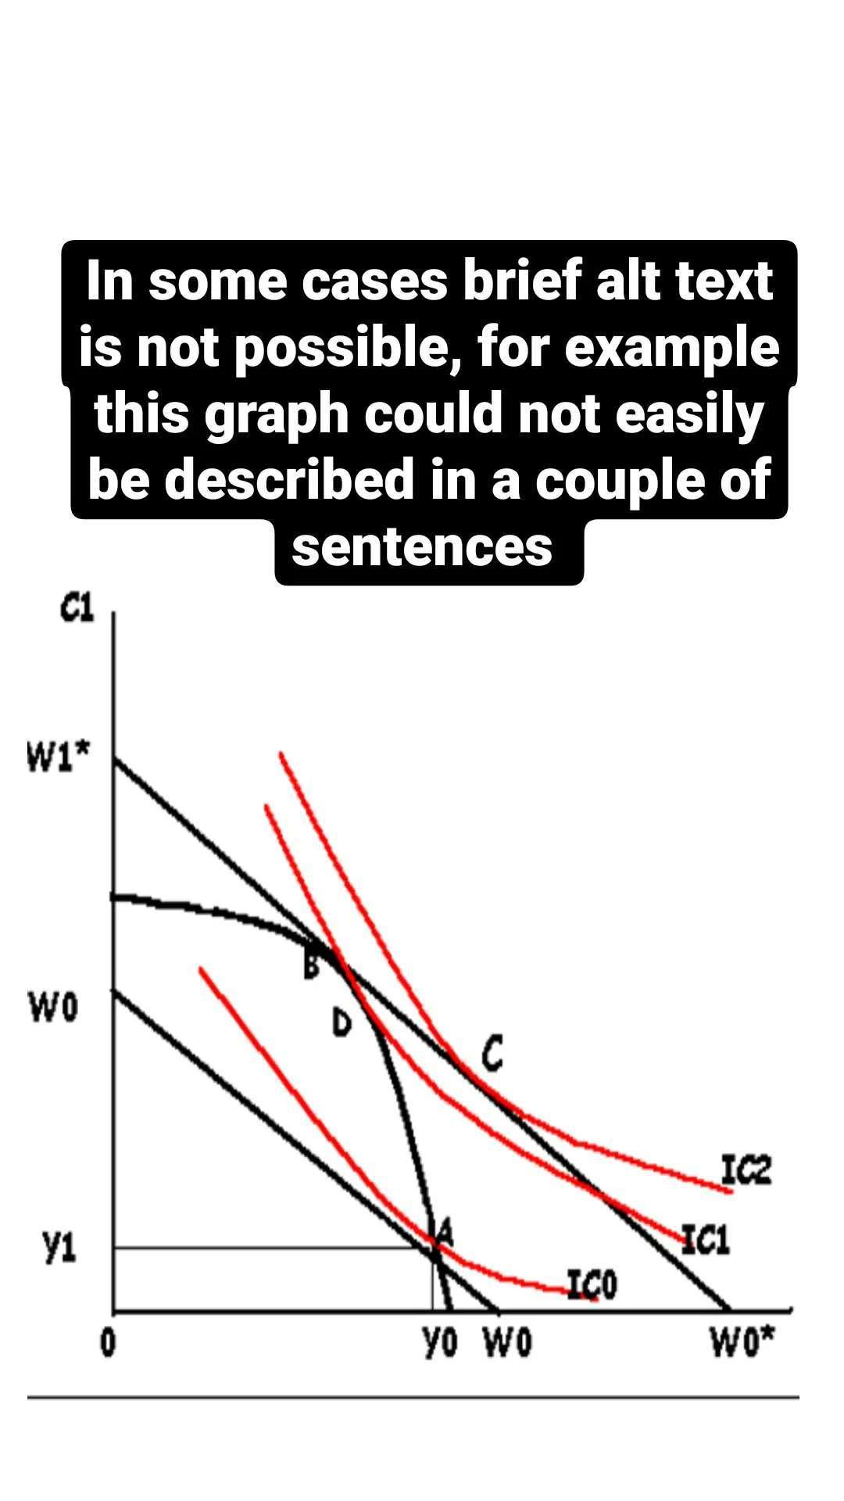
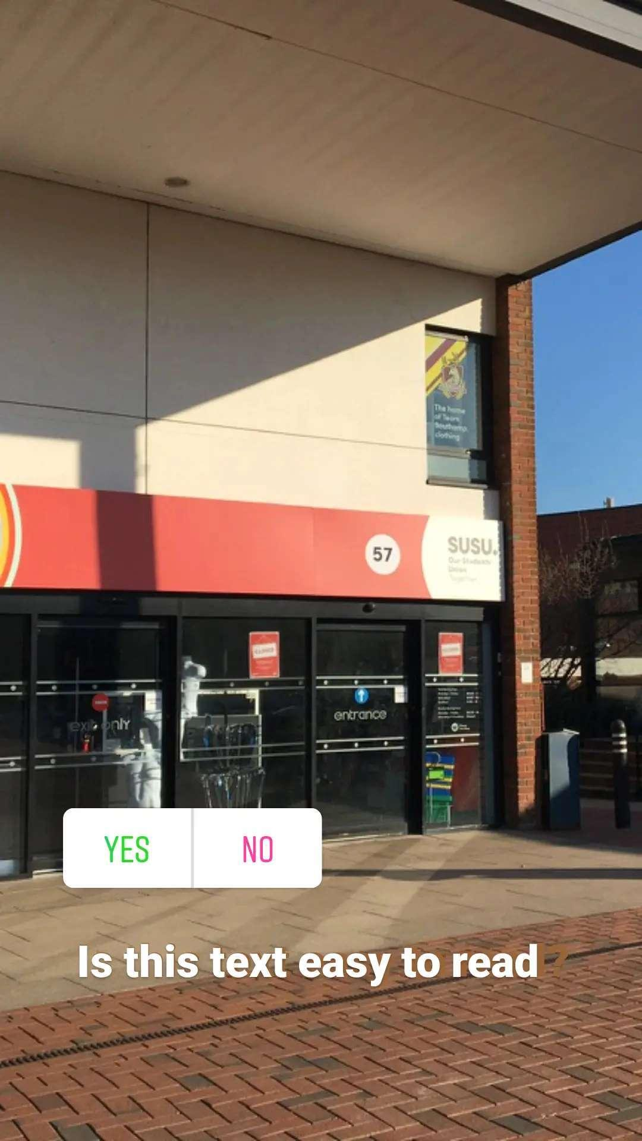
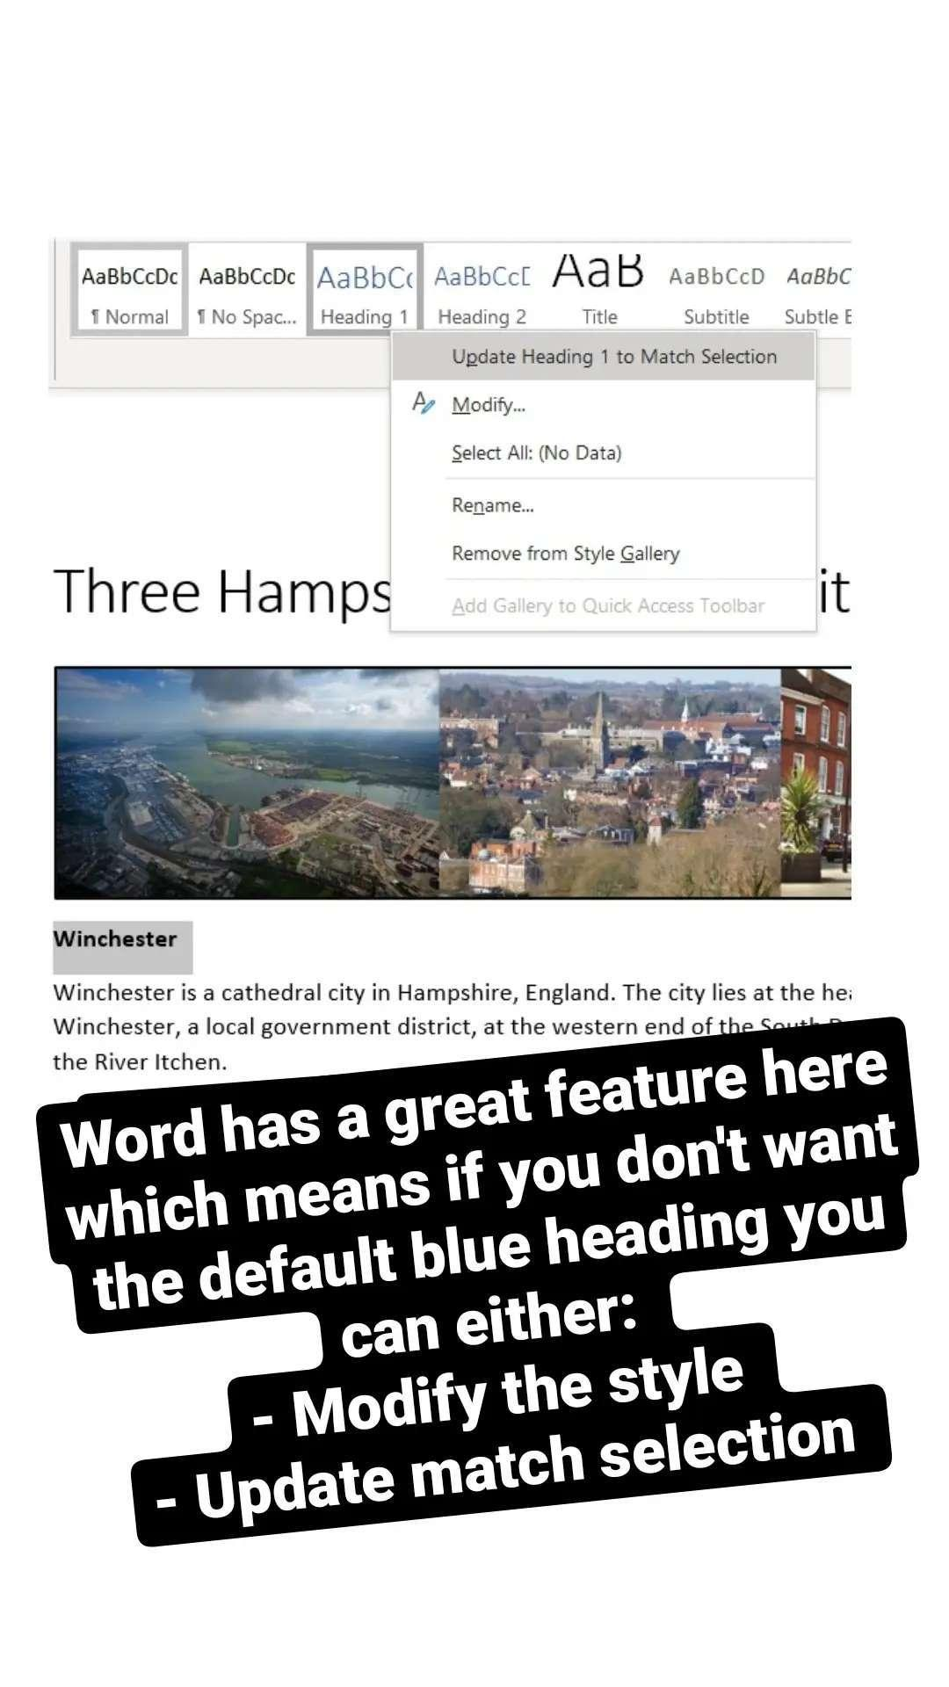
Instagram Takeover
Notes:
Sarah
Our allies organised an “Instagram takeover” of the Student Union’s account, spreading the word about accessibility and sharing quick fixes and techniques.
This is a good example of utilising students for student engagement - a platform we have little team experience with, but the students are very comfortable using.
“Next slide please Helen”

Slide 26
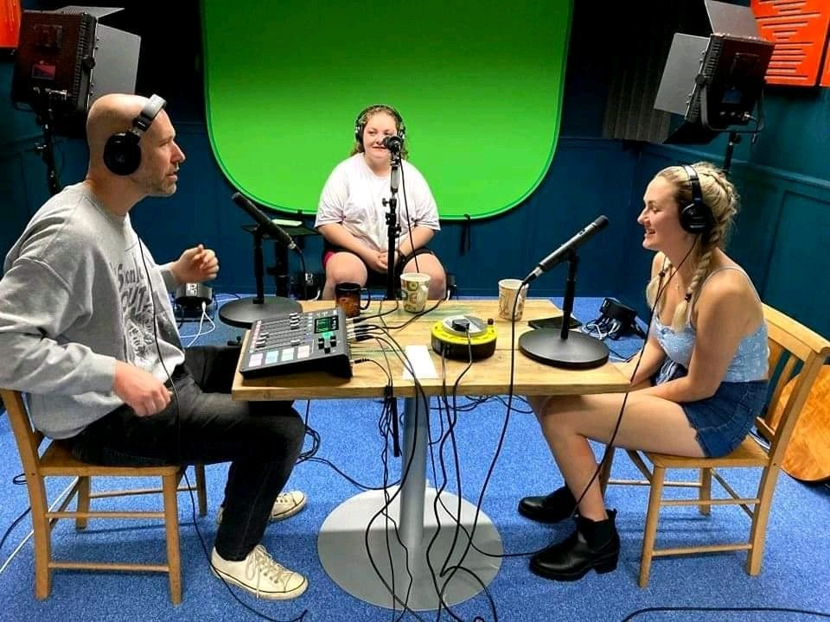
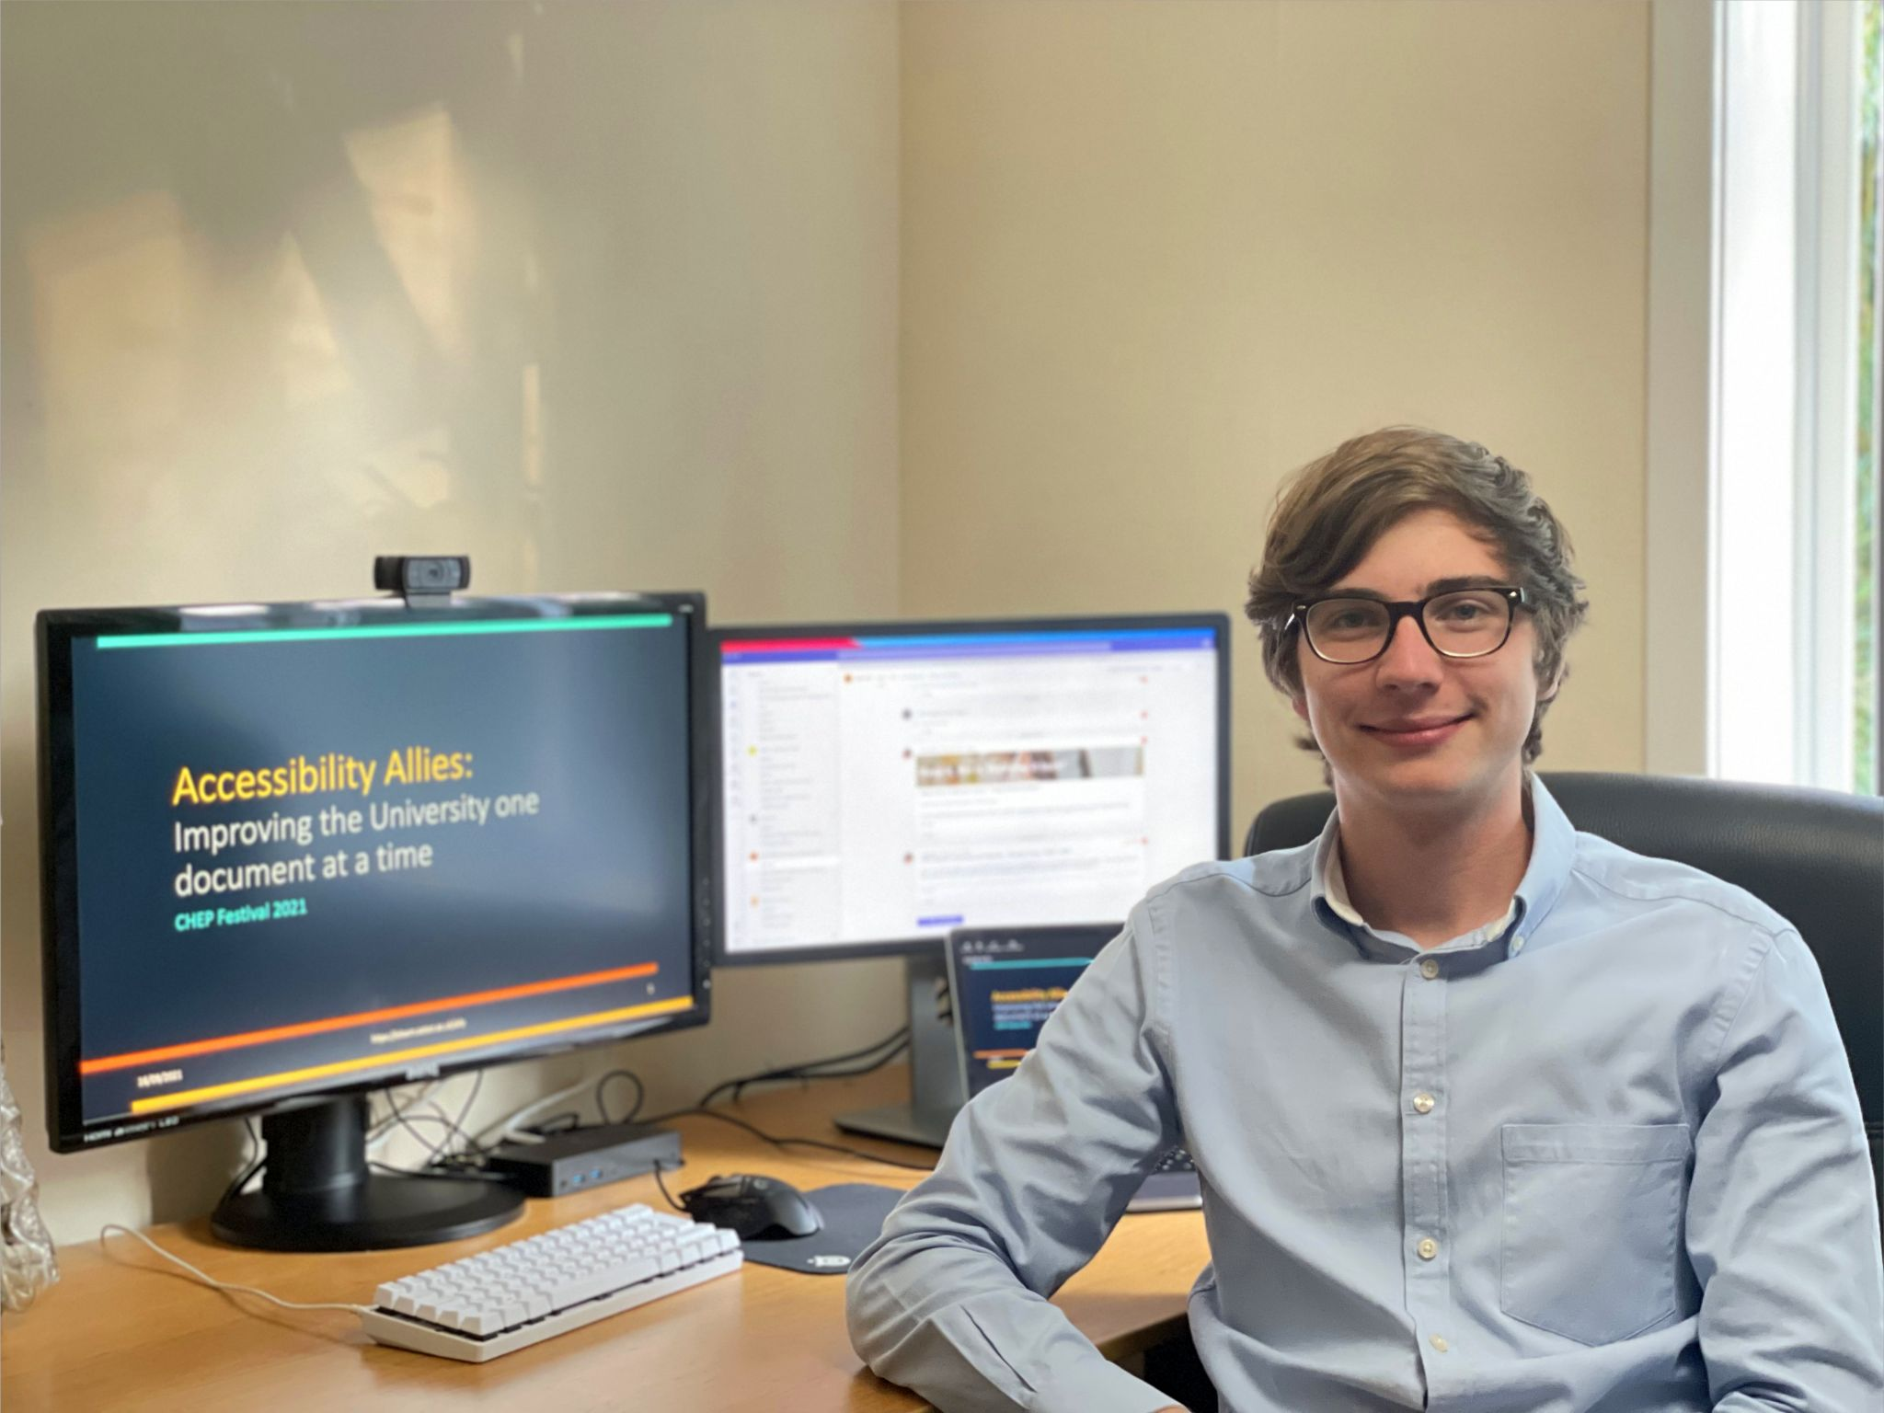
Podcasts and Presentations
Notes:
Sarah
Charlotte and Emily were invited guests on the Teaching and Scholarship Podcast. This is a well established UoS podcast whose primary audience is academic staff.
This provided a chance to share the student perspective of their work and accessibility in general.
Our allies were also encouraged and supported in giving presentations to different audiences. They presented at an academic conference, highlighting quick wins to faculty staff.
They also presented to IT managers and our educational services group, demonstrating the impact of their work and offering tips on running successful internships.
“Next slide please Helen”

Slide 27
Accessibility Allies! 4
Accessibility Allies
Preparation and initiation
Module remediation work
Additional activities
Reflecting on the internship
Notes:
Sarah
So now we come to reflect on this internship programme and it’s impact.
“Next slide please Helen”

Slide 28

How much impact?
24 modules remediated with 6000+ students enrolled.
Average 4 days per module.
10 debrief meetings.
Files
Average start score: 33%
Average end score: 67%
Average overall improvement: +87%
Notes:
Sarah
How much impact did our allies have?
Over 11 weeks they remediated 24 modules on which a total of more than 6000 students were enrolled. Some of the modules were particularly large which meant there would be a significant impact through improving the accessibility of the resources within.
It took the allies four days on average to remediate a module and they led ten debrief meetings with module leaders. The number of meetings that could be arranged was dependent on staff availability.
Most importantly, when we look at the average file accessibility scores for modules, the allies achieved an 87% average increase. A tremendous achievement!
“Next slide please Helen”

Slide 29
Comparing across faculties
Notes:
Sarah
Across the faculties there was quite a variance in the number of module leaders who accepted our offer to improve their modules. As you would expect, the type of accessibility issues, the number of files, the complexity of the modules and their materials varied across faculties and subject areas. Across each of the faculties our allies achieved significant improvements in the file accessibility scores.
“Next slide please Helen”

Slide 30
Who benefits?
Students on future deliveries of the module.
Students on other modules, where remediated materials have been re-used or repurposed.
Staff responsible for modules.
More than 6000 students enrolled on the remediated modules.
Notes:
Sarah
So who benefits from this work?
Staff benefit from having the remediation done on their modules and through a tailored debrief with opportunities for them to ask questions and perhaps to even have a chance to get ahead of their colleagues.
This does not only benefit the large number of students enrolled on the modules that the allies remediated.
Considering our aim to sustain improvements by remediating original files and not PDFs the students who go on to take those modules in the next few years will also benefit from more accessible materials. If remediated content is repurposed or reused on further modules then more students will benefit too.
“Next slide please Helen”

Slide 31
Feedback from staff 3
High-quality communication.
Use of objective stats in the debrief.
Explanation of accessibility issues and how to resolve them going forward.
Notes:
Sarah
We had great feedback from staff.
They consistently praised the high-quality communication from the allies, from introducing themselves, explaining the work they would be doing on their module, to leading the debriefs.
Module leaders told us they found the debriefs very valuable, from the use of the accessibility score before and the work, and particularly in the way the allies identified common accessibility issues.
The allies approach of explaining the importance of these issues and how to resolve them, meant that the staff are more prepared to take on these behaviours into the future.
“Next slide please Helen”

Slide 32
Let’s hear again from our interns
Notes:
Sarah
Let’s hear again from Sian and Velina, starting with whether their perception of digital accessibility has changed?
“Please could you play this video for us Helen?”
[After video finished] Now I’ll hand back over to Matt to bring our presentation to its conclusion.
“Next slide please Helen”

Slide 33
What would we do differently? 22
Better administration.
More structured stand-ups?
Prepare the ground more with academic colleagues.
Notes:
Matt
Knowing what we know now, what would we do differently?
We could definitely tighten up our administrative processes. For example , using planner to allow induction tasks to be “ticked off” allowing for more independence and self-pacing, better recording of decisions, and ensuring accessibility data was kept within a single source.
It’s easy to forget that some practices may feel new and uncomfortable to interns. While we wanted the stand-ups to be intern-led but we could have provided more structure and set expectations to make them feel more comfortable.
We would want to prepare the ground better with academic colleagues, by asking them to review and remove superfluous content first.
And make really clear that if they make changes to the module during remediation that it’s important to tell us.
“Next slide please Helen”

Slide 34
Next steps
Scientific notation
Outreach
Digital literacy, including accessibility
Notes:
Matt
In terms of our next steps, we’re working on identifying good workflows for making scientific notation accessible, and more outreach and support activities.
Common feedback from staff was that no one ever told them how to use certain basic features in Word like Heading Styles, and this feeds into our wider-work on increasing the Digital Literacy or University staff and students.
“Next slide please Helen”

Slide 35
Final thoughts
This is only one aspect of addressing digital accessibility at a University.
An institution-wide approach is required in order to sustain accessibility.
Notes:
Matt
Of course remediation of module content is only one aspect of digital accessibility within a University.
An institution-wide approach means that we consider digital accessibility in everything a University does, from IT services, through procurement, communications, teaching and so on. Accessibility should be embedded within policies and processes so that it’s not an “add-on” or “extra” but just part of what we do.
“Next slide please Helen”

Slide 36

Making IT accessible for all
03 December 2021 10:00 - 11:00
Book: https://bit.ly/3vmiijh
Approaches to building a digital accessibility policy for university IT departments.
Techniques for embedding accessibility within IT development processes by ‘shifting left’.
Examples from within the Higher Education and wider IT sectors.
Notes:
Matt
I’ll be presenting alongside colleagues from Southampton and UCL, on the topic of how digital accessibility can be embedded within the policies and processes of University IT departments, which is another aspect of that institution-wide approach. Those who work in institutions that are UCISA members can book to attend the session via this link, which is also on the web page we mentioned earlier.
“Next slide please Helen”

Slide 37

Thank you
Notes:
Matt
Thanks for listening and thank you especially to AbilityNet for inviting us. Back to you Helen.

